Slide 1


Battery(Cells) Charger Discharger System and ITS Testing Safety Procedure
SHRESTHA Hari Ram (D2), Cho Lab
shrestha.hari-ram852@mail.kyutech.jp
LaSEINE , Kyushu Institute of Technology

Slide 2

Charge/Discharge system with four cell switcher
Introduction
A charge/discharge system is a system to assist cell matching and construction of a custom battery using COTS cells. The cells are screened on the system and generates the required data
The system is used to screen and get acceptable batteries after checking the physical and electrochemical characteristics of each cell after every test (Thermal vacuum and Vibration Test)
The screening system shall fulfill the safety review requirement for launch providers, JAXA or ISS.

Slide 3
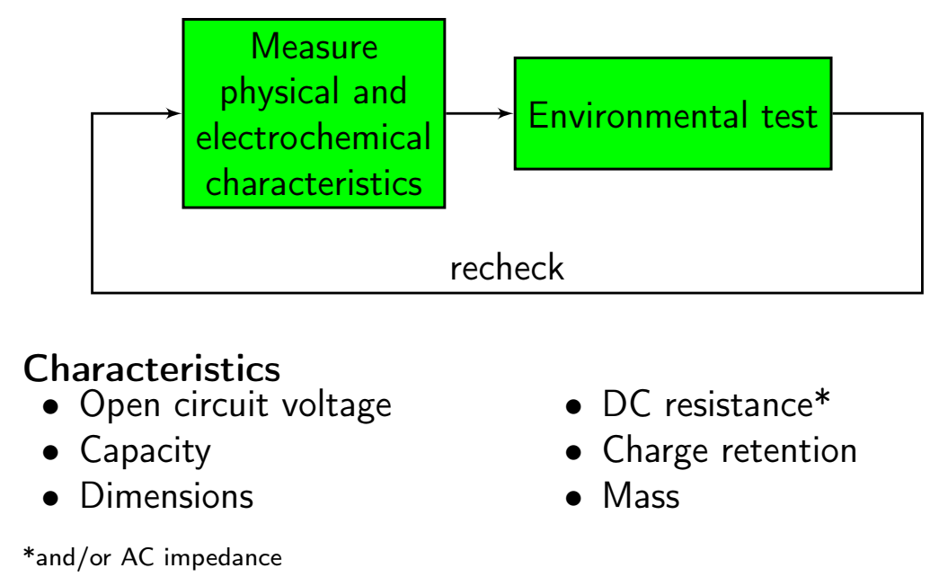
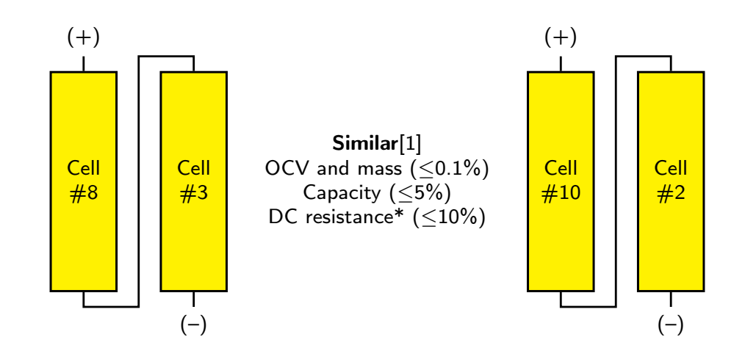
Cell Matching process
Cells’ acceptance screening
Cell matching process
OBJECTIVE
OBJECTIVE
Find defects
Assemble the best batteries
Avoid unbalanced voltages
Mitigate the state of charge imbalance

Slide 4
Charge/Discharge Method
Method:
Design and fabrication of a 4-cell switcher with temperature and voltage sensors.
Design and fabrication of a charger/discharger using a buck/boost Zeta converter.
Design and implementation of an embedded converter controller.
Implementation of logger software in LabVIEW.

Slide 5

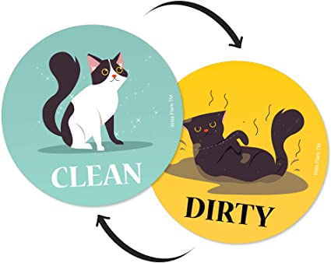
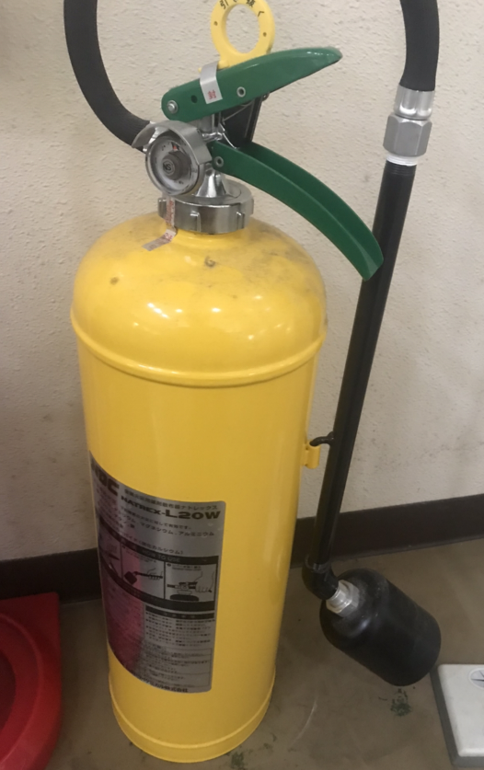


Safety Precautions
1
2
Source: internet
1. Wear the Gloves on your hand before starting the work
Amazon.jp
3. Keep the Fire Extinguisher near about the test system
2. Clean, sort and shine
a) Keep all the components and devices of the system in an arrangement
b) Always keep away the extra batteries from the work test bench
c) Do not place metallic conductive material near about the battery charging place
d) Keep away Heat source and soldering irons near the system
3
Fire Extinguisher

Slide 6
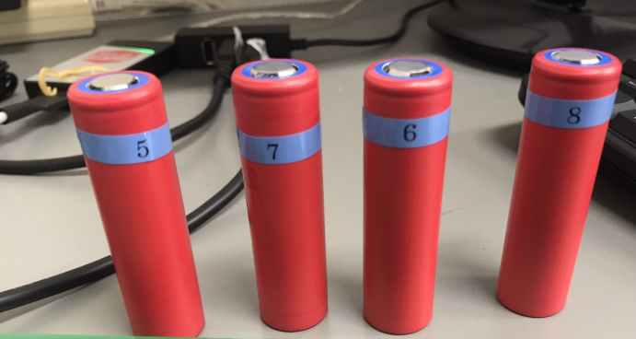
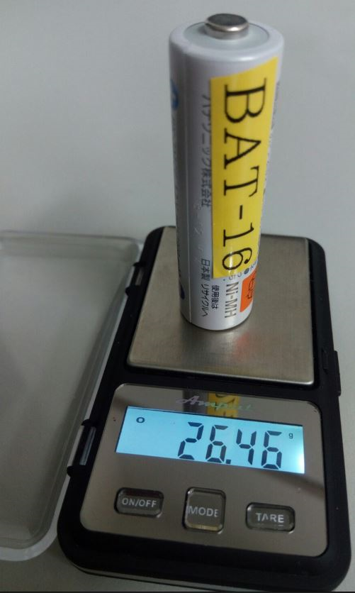
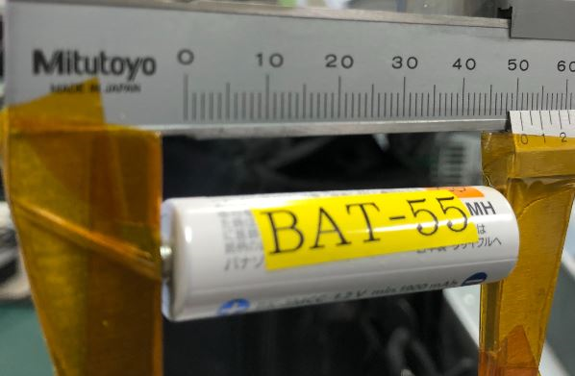
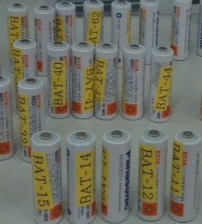
Initial Preparation
4
Sanyo NCR 18650 GA battery (cells)
4. Before the test confirm by the appearance check and physical measurement
Scratch
Rust
Dirt
Deformation
Discoloration
Leakage
Label(tag)
Measure voltage(OCV), mass, dimension of batteries
Measuring Dimension, length and mass of each cell
Panasonic eneloop NiMH
5 . Make sure to not mix the batteries on test (old & new ,different chemistry or different model)

Slide 7
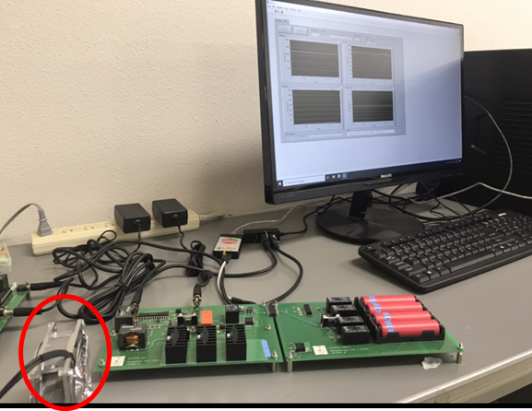
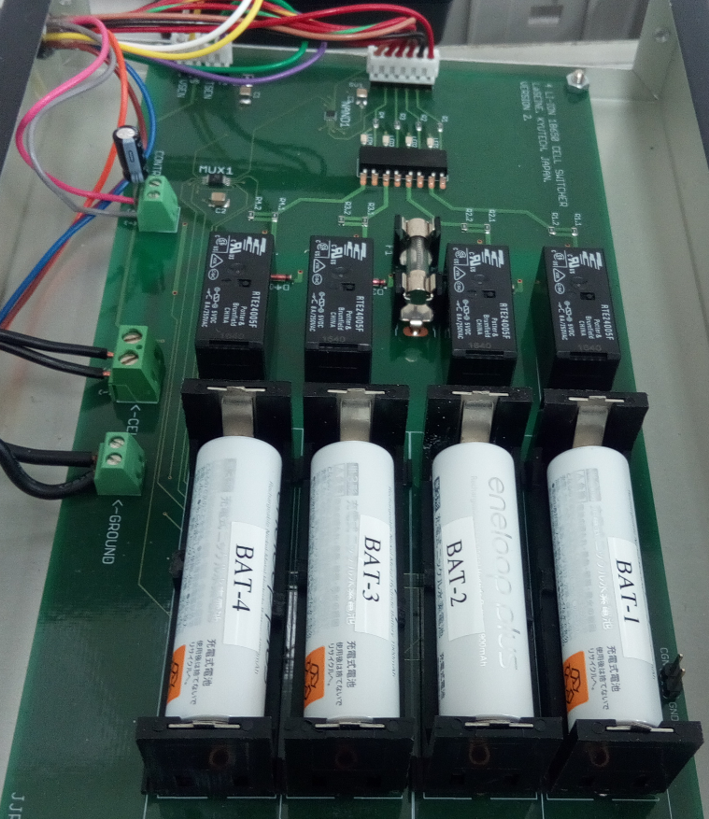

Initial Preparation
6. Connect the required cables and turn on all components and devices for System (Adapter, Cooling Fan, Computer, software)
7. Put the battery(cells) properly into the battery holder with on cell switcher.
LAB VIEW
adaptor
6
NiMH cell switcher
$$\left(+ \right) ( −)$$
7
1st . Install four cells at Cell Switcher
Li-Ion cell switcher
Charger/Discharger
Cooling Fan
Charger-Discharger System

Slide 8
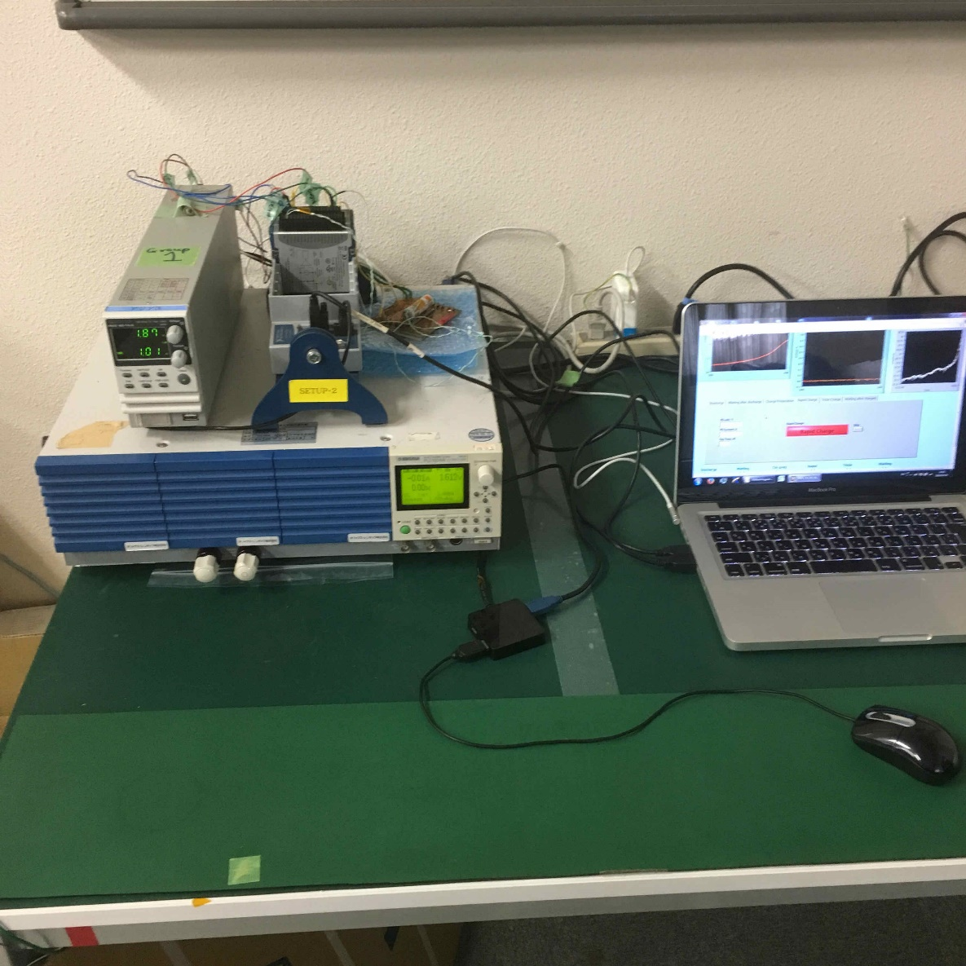
Testing Procedure
Previous Charge discharge setup
Power source and electronic load connected to one cell
Powerful equipment, high cost
Unavailability of power supply and loads
Inaccuracy of measurements
Limited qualified users
One cells take a time 6 hours

Slide 9
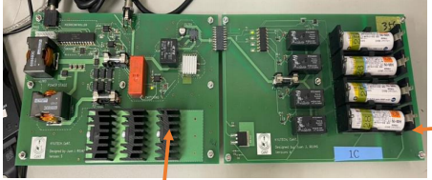
Testing Procedure
cell switcher
Charger/discharger system connected to four cell switcher
Customized for its purpose, low cost
Replacement for the electronic load, power supply
Short distance inter connection
Can do the Parallel testing
Four cells one after other
4 hours for one cells
Increased safety
Power resistor
Charger/discharger
New setting
~7.5V

Slide 10
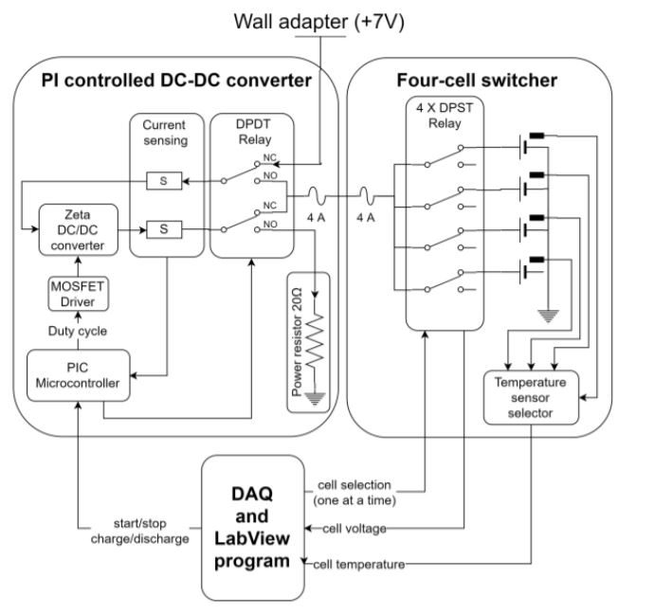
How to operate
State 1:Converter work as a buck converter
Relay is set in charging position(NC),the power source is connected to the converter input and the cell switcher is connected to the output.
State 2:Converter work as a boost converter
Relay is set in discharging position(NO),the cell switcher is connected to the input and power resistor is connected to the output.

Slide 11
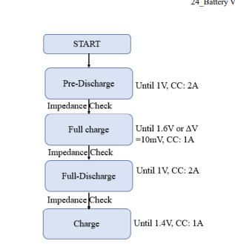
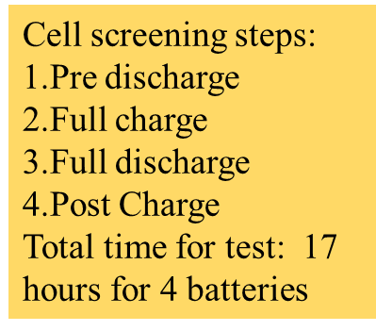
Steps

Slide 12
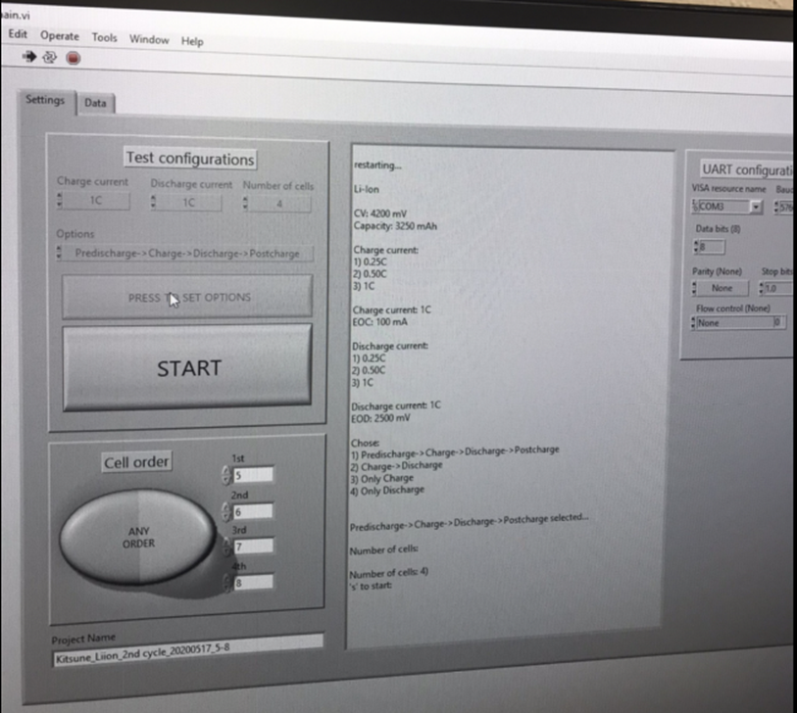
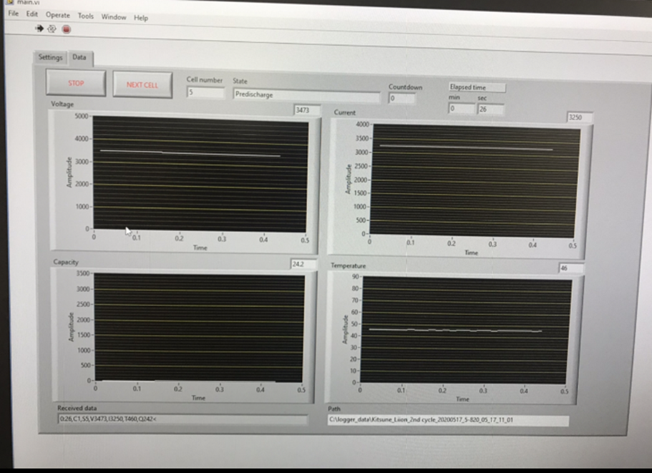
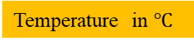
How to Operate
Voltage in mV
Current in mA
3rd . Press button
2nd . Define settings and cell order
Temperature in $℃$
Capacity in mAH
4th . Press Start for screening
8. Monitor the battery temperature frequently from display or touch cells, if you notice the battery is going hot then the system should be turned off and take out the battery
7. Do not leave the system during in operating time

Slide 13
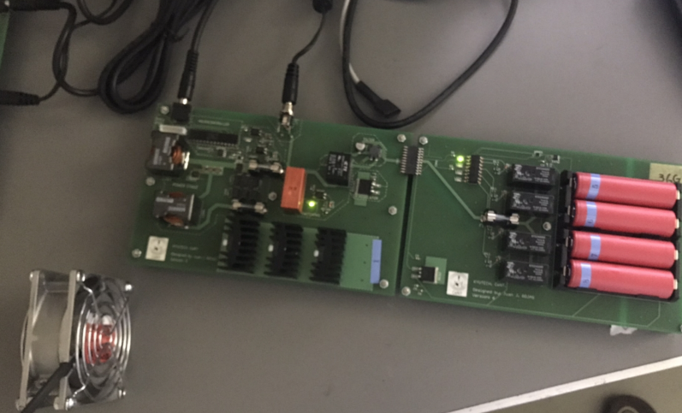
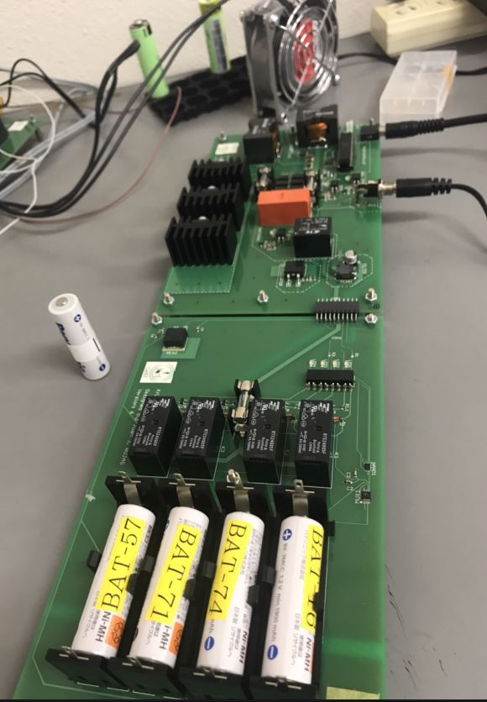
Monitor & Handling
9. Do not touch and move the system On test time
NiMH cells screening
Li-Ion cells screening
10. After completed the test, firstly stop the system and take out the battery(Cells) properly.
During on test time of system

Slide 14
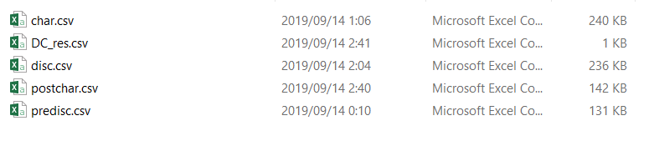

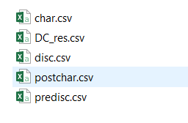
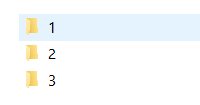
preparation for data analysis
Results can get into .csv file.
Need to change the name in short form
Do the exactly same name in short form with out any mistake.
No 1,2… are the battery(cells)
The folder inside the 1,2,3 are the cycles,
1=Before Vacuum test
2=After vacuum Test
3= after vibration test

Slide 15
Results
MATLAB programming

Slide 16
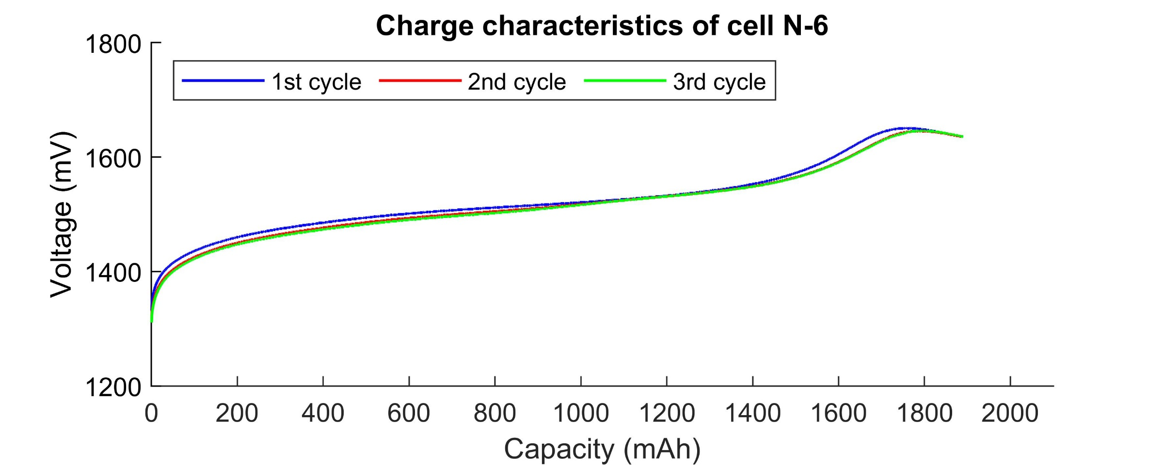
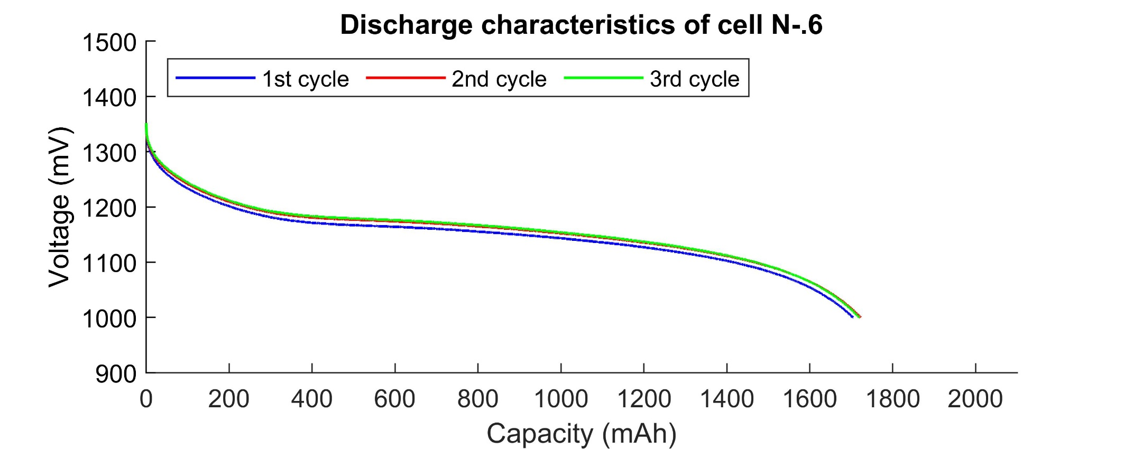
Results graph
charge
discharge

Slide 17
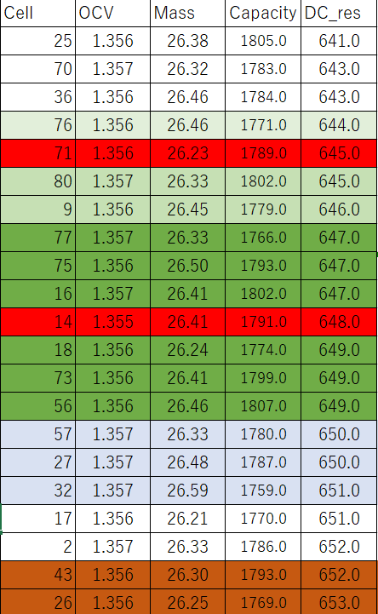
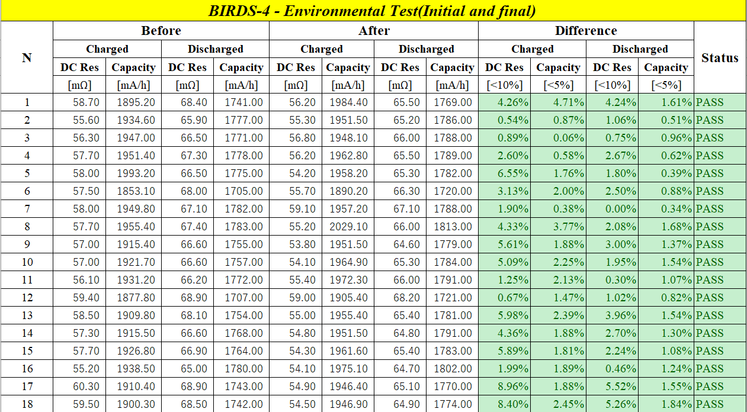
Results : environmental test and cell matching
Cell matching process
Comparison the data of environmental test

Slide 18
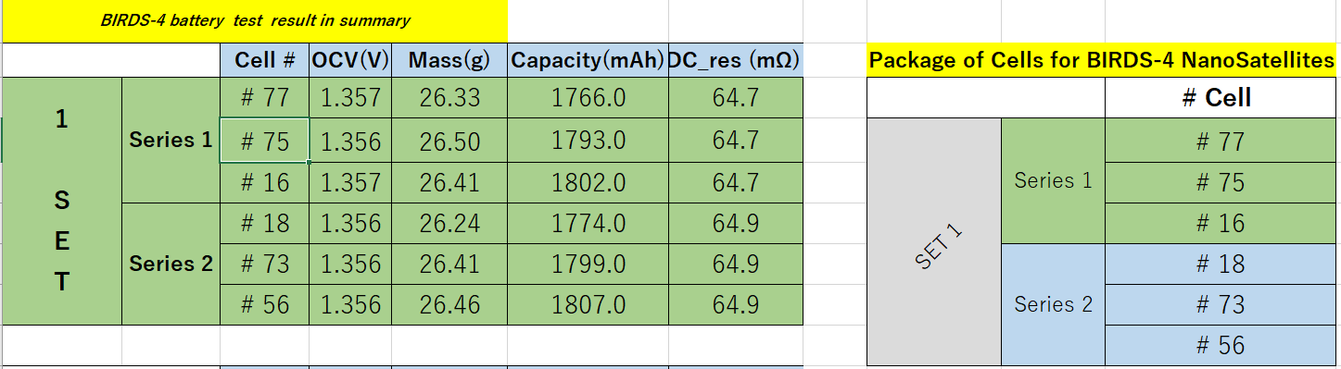
Battery packing

